Slide 1
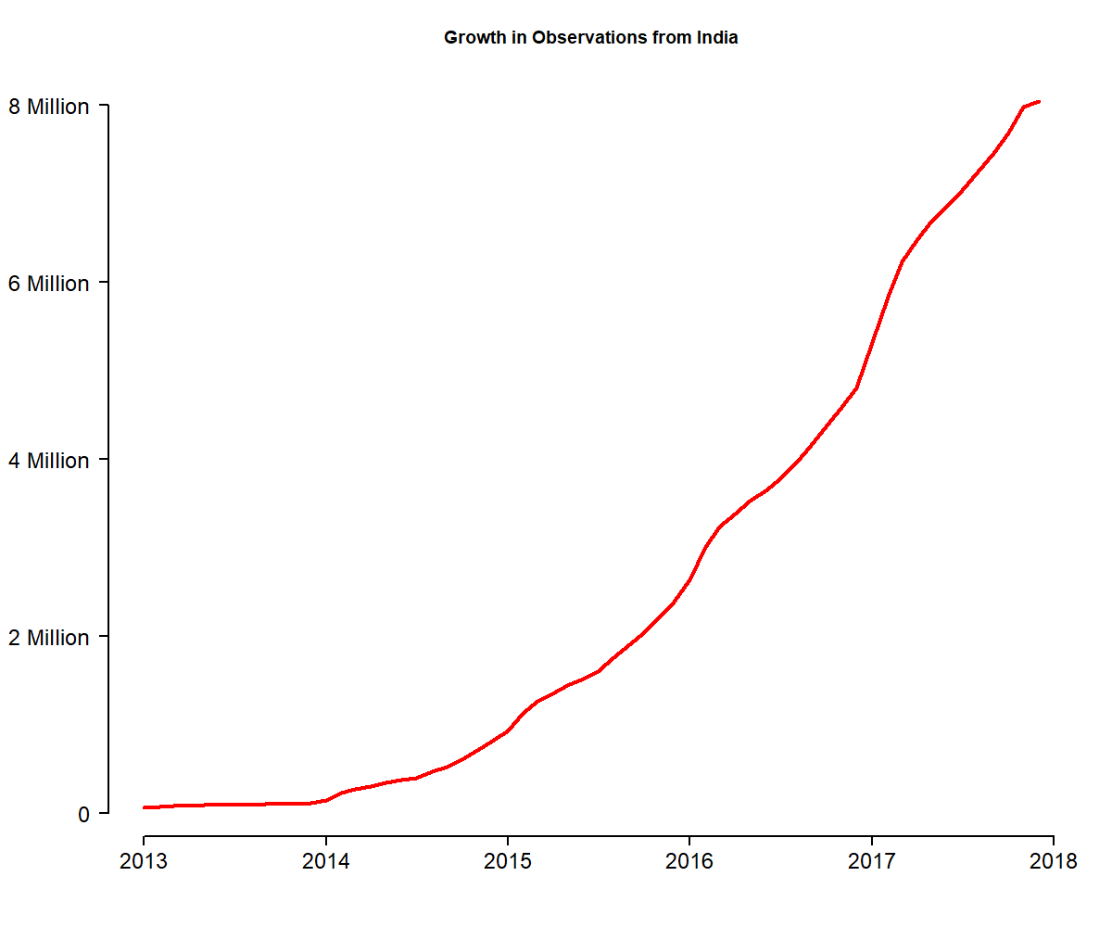
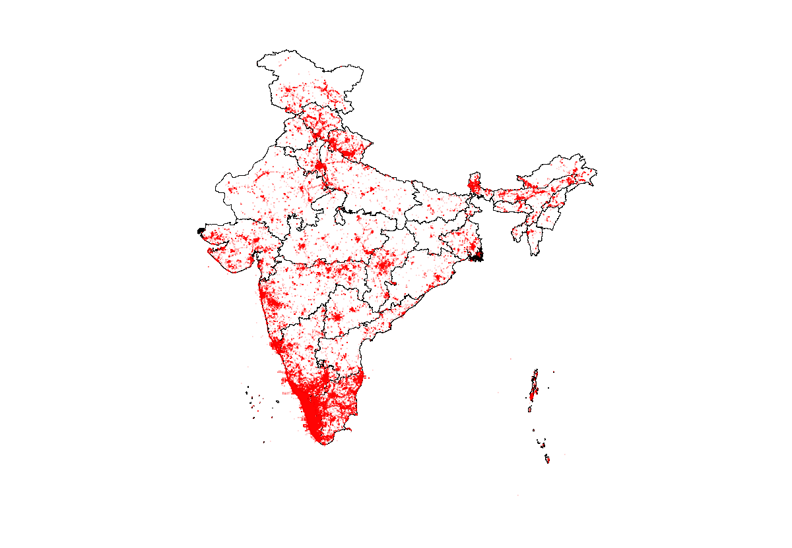
Growth in Observations from India
8 Million Observation
10 Thousand Observers
446 Thousand Lists

